Slide 1
Lecture 15. Decision Trees¶
CS 109A/AC 209A/STAT 121A Data Science:
Harvard University
Fall 2016
Instructors: P. Protopapas, K. Rader, W. Pan

Slide 2
Announcements
Projects. Milestone 3 is due Saturday
HW5 solutions coming soon. Few students had medical emergencies so we will not release until everyone is done

Slide 3
Quiz
Code: willbyers

Slide 4
Outline
Tree based methods
Regression Trees
Classification Trees
Bagging

Slide 5
Outline
Tree based methods
Regression Trees
Classification Trees
Bagging

Slide 6

Tree-based methods

Slide 7
Basic Idea

Slide 8
x₂
Region2
Region1
x₂ª
Region3
x₁ª
x₁

Slide 9
X₁<x₁ª
x₁>x₁ª
X₂<x₂ª
x₂>x₂ª

Slide 10
Basic Idea
Segment the predictor space into sub-regions and we learn from the training set the value to predict as the mean or mode or median of the respond variable of the training examples that are in that segment.

Slide 11
Why Trees?
What would you do tonight? Decide amongst the following:
Finish homework
Go to a party
Read a book
Hang out with friends

Slide 12
Homework Deadline tonight?
Yes
No
Do homework
Party invitation?
Yes
No
Do I have friends
Go to the party
Yes
No
Read a book
Hang out with friends

Slide 13
Why Trees?
We split the predictor space as brunches of a tree and therefore these methods are called decision tree methods

Slide 14

Why Forest?
Not the most powerful models but using multiple trees as in bagging, random forests and boosting yield much better results.

Slide 15
Outline
Tree based methods
Regression Trees
Classification Trees
Bagging

Slide 16
Regression
Build a regression tree:
Divide the predictor space into J distinct not overlapping regions R₁,R₂,R₃,…,R_{J}
We make the same prediction for all observations in the same region; use the mean of responses for all training observations that are in the region

Slide 17
x₂
Region2
Region1
y=2.2
y=3.2
Region3
y=5.6
x₁

Slide 18
Finding the sub-regions
The regions could have any shape.
But we choose just rectangles
x₂
Region2
x₂
Region2
Region1
Region1
Y=2.5
y=2.2
Y=2.9
Y=3.2
Region3
Region3
Y=5.1
y=5.6
x₁
x₁

Slide 19
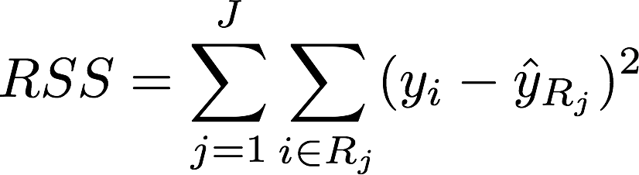

Find boxes R₁, . . . , R_{J} that minimize the RSS
where is the mean response value of all training observations in the R_{j} region
This computationally very expensive!
Solution: Top down approach, greedy approach
recursive binary splitting

Slide 20
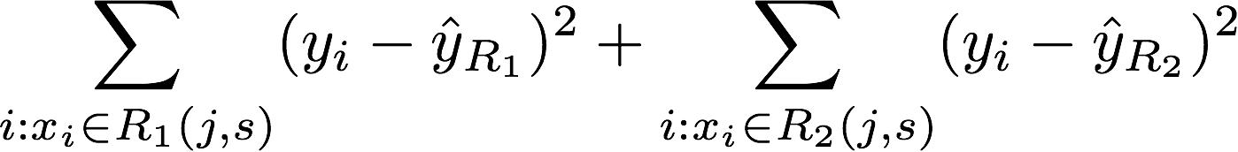
Recursive Binary Splitting
Consider all predictor X_{p} and all the all possible values of the cutpoints s for each of the predictors. Choose the predictor and cutpoint s.t. it minimizes the RSS
This can be done quickly, assuming number of predictors is not very large
Repeat #1 but only consider the sub-regions
Stop: node contains only one class or node contains less than n data points or max depth is reached

Slide 22
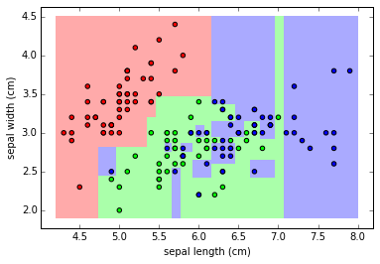
Overfitting
If we keep splitting we will be reducing RSS

Slide 23
Pruning
Fewer splits or fewer regions lower variance better interpretation at cost of little more bias
Ideas?
Stop splitting when RSS improvement is lower than a threshold
Smaller trees but not effective (short sighted)
A split early on in the tree might be followed by a very good split; a split that leads to a large reduction in RSS later on

Slide 24
Pruning
Better is to grow a large tree and then look subtrees that minimize the test error
How?
Cross-validation of all possible subtrees?
This is too expensive
Cost complexity pruning—also known as weakest link pruning

Slide 25
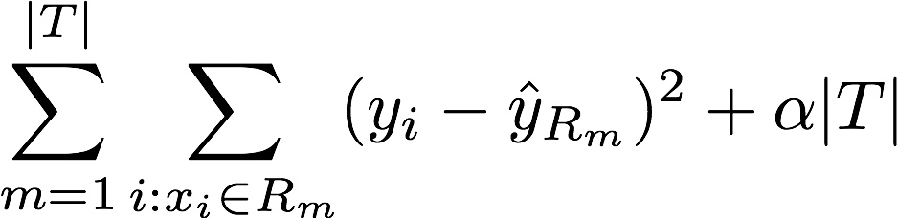
Cost complexity pruning
Consider a tuning parameter α that for each value of α there is a subtree that minimizes
Where |T| is the number of terminal nodes. α controls the complexity of the tree similarly we saw with other regularizations (e.g. LASSO).
It turns out that as we increase α from zero in, branches get pruned from the tree in a nested and predictable fashion, so obtaining the whole sequence of subtrees as a function of α is easy.
Notes:
If a is zero this is the full tree … a large only root node

Slide 26
ALGORITHM FOR PRUNING
Use recursive binary splitting to grow a large tree on the training data, stopping only when each terminal node has fewer than some minimum number of observations
Apply cost complexity pruning to the large tree in order to obtain a sequence of best subtrees, as a function of α
Use K-fold cross-validation to choose α
Repeat #1 and #2 on the k-th fold
Estimate the MSE as a function of α
Average all and pick α
Return the subtree from Step 2 that corresponds to the chosen value of α

Slide 27
Hitters data set:
Response variable: baseball player’s Salary
Predictors:
Years (the number of years that he has played in the major leagues)
Hits (the number of hits that he made in the previous year)
Walks, RBI, hits, putouts
Note: log-transform Salary so that its distribution has more of a typical bell-shape.

Slide 28
Notes:
How come test has error bars

Slide 29
Notes:
How come test has error bars

Slide 30
Outline
Tree based methods
Regression Trees
Classification Trees
Bagging

Slide 31
Classification Trees
Very similar to regression except that it is used to predict a qualitative response rather than a quantitative one
In regression trees we use the mean response of the training observations for classification trees we use most commonly occurring class
Interested in the class proportions of each region

Slide 32
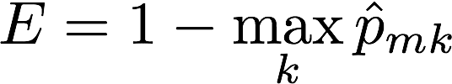

Classification Trees
We learn the model using recursive binary splitting as with the regression trees except …
RSS cannot be used as a criterion for making the binary splits.
Classification error rate:
represents the proportion of training observations in the m-th region that are from the k-th class

Slide 33
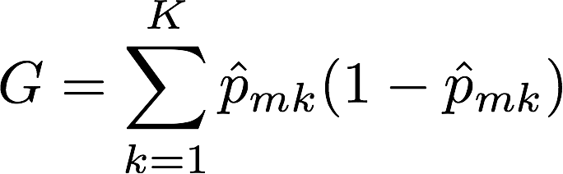
Gini index
Classification error is not differentiable or sensitive enough for tree growing.
Purity of the nodes, Gini index
G takes small values when p_{mk} is small or close to 1, therefore is a measure of purity of the nodes.

Slide 34
Gini index
Example:
5 red, 2 blue and 3 green
red:
5/10*(1-5/10) = 0.25
blue:
2/10*(1-2/10) = 0.16 G=0.61
green:
3/10*(1-3/10) = 0.21

Slide 35
Misclassification
Example:
5 red, 2 blue and 3 green
Proportions p_{mk} for each class are: 5/10, 2/10, 3/10
max_{k}(p_{mk}) = 5/10
Classification error
E = 1-1/2=1/2

Slide 36
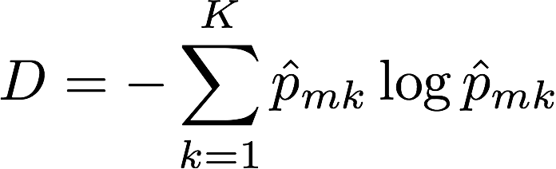
Cross entropy
Alternative to the Gini index is cross entropy
D>0 and will take value near zero when p_{mk} is either near zero or one
Notes:
Information gain or

Slide 37
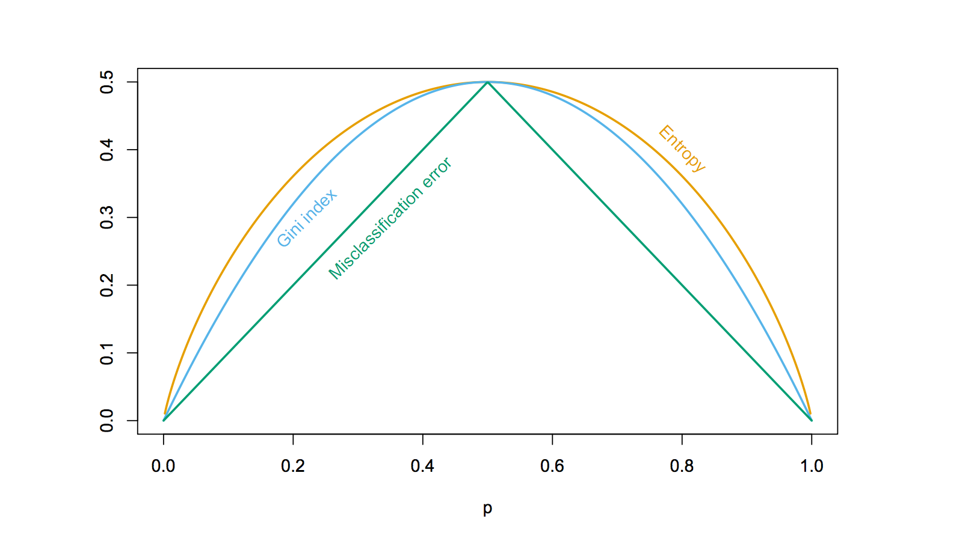
Node impurity for two class problem
Hastie et al.,”The Elements of Statistical Learning: Data Mining, Inference, and Prediction”, Springer (2009)

Slide 38
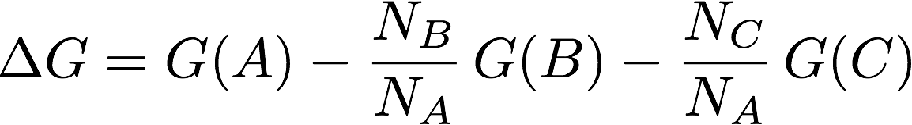
Node Purity Gain
Compare:
– Gini impurity of parent node
– Gini impurity of child nodes
A
B
C

Slide 39
Pruning classification Tree
Use the same algorithm as for regression tree but instead of RSS use Gini index or Entropy
HOWEVER: classification error rate is preferable for the final pruned tree

Slide 40
Example: Heart data set
303 patients who presented with chest pain
Response takes values Yes/No indicates the presence of heart disease
13 predictors including Age, Sex, Chol (a cholesterol measurement), and other heart and lung function measurements
Cross validation

Slide 41
Notes:
Note: Categorical variables such as Thal test
Note: Yes and Yes ! Purity is important here. Right is 100% where left 7/11. Important when predicting

Slide 42
Comparison to linear models

Slide 43
Outline
Tree based methods
Regression Trees
Classification Trees
Bagging

Slide 44
Advantages of tree based methods
Easy to explain
Handle qualitative predictors
Display graphically and easy to interpret
More similar to human decision making

Slide 45
Disadvantages
Non robust. Sensitive to small changes in the data
Trees generally do not have the same level of predictive accuracy as some of the other regression and classification approaches we have seen
Only axis aligned splits

Slide 46

Power of the crowds
Wisdom of the crowds
http://www.scaasymposium.org/portfolio/part-v-the-power-of-innovation-and-the-market/

Slide 47
Ensemble methods
A single decision tree does not perform well
But, it is super fast
What if we learn multiple trees?
We need to make sure they do not all just learn the same

Slide 48
Bagging
If we split the data in random different ways, decision trees give different results, high variance.
Bagging: Bootstrap aggregating is a method that result in low variance.
If we had multiple realizations of the data (or multiple samples) we could calculate the predictions multiple times and take the average of the fact that averaging multiple onerous estimations produce less uncertain results
Notes:
General purpose method, here only for decision trees

Slide 49
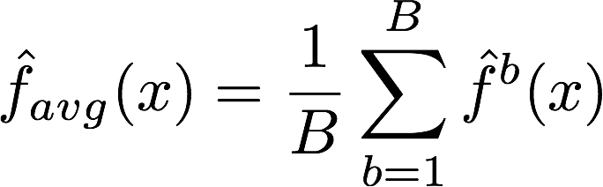
Bagging
Say for each sample b, we calculate f^{b}(x), then:
How?
Bootstrap
Construct B (hundreds) of trees (no pruning)
Learn a classifier for each bootstrap sample and average them
Very effective
Notes:
No pruning, high bias high variance

Slide 50
Bagging for classification: Majority vote
Test error

Slide 51
Out-of-Bag Error Estimation
No cross validation?
Remember, in bootstrapping we sample with replacement, and therefore not all observations are used for each bootstrap sample. On average 1/3 of them are not used!
We call them out-of-bag samples (OOB)
We can predict the response for the i-th observation using each of the trees in which that observation was OOB and do this for n observations
Calculate overall OOB MSE or classification error
Notes:
equivalent to leave-one-out cross-validation error
1/N to choose, 1-1/N not to choose, (1-1/N)N and (1-1/N) 1-(1-1/N)N 1-e^(-1)

Slide 52
X₂
X₁

Slide 53
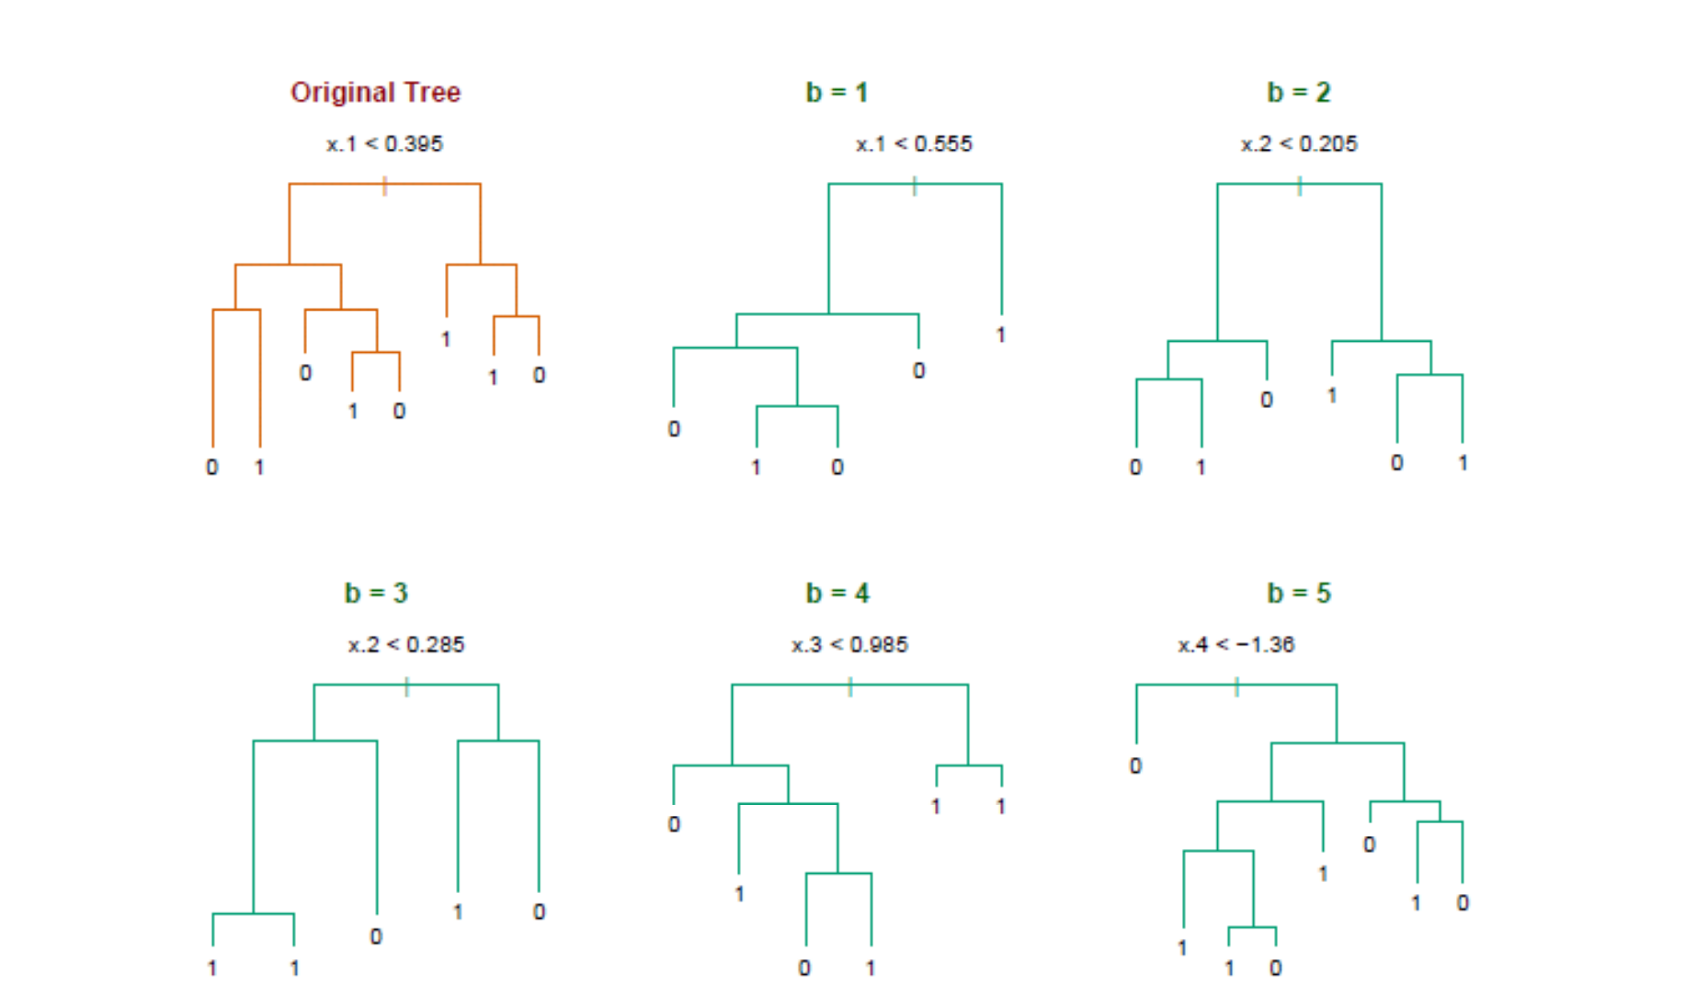
Bagging decision trees
Hastie et al.,”The Elements of Statistical Learning: Data Mining, Inference, and Prediction”, Springer (2009)

Slide 54
Bagging
Reduces overfitting (variance)
Normally uses one type of classifier
Decision trees are popular
Easy to parallelize

Slide 55
Variable Importance Measures
Bagging results in improved accuracy over prediction using a single tree
Unfortunately, difficult to interpret the resulting model. Bagging improves prediction accuracy at the expense of interpretability.
Calculate the total amount that the RSS or Gini index is decreased due to splits over a given predictor, averaged over all B trees.

Slide 57
Different flavors
ID3, or alternative Dichotomizer, was the first of three Decision Tree implementations developed by Ross Quinlan (Quinlan, J. R. 1986. Induction of Decision Trees. Mach. Learn. 1, 1 (Mar. 1986), 81-106.)
C4.5, Quinlan's next iteration. The new features (versus ID3) are: (i) accepts both continuous and discrete features; (ii) handles incomplete data points; (iii) solves over-fitting problem by (very clever) bottom-up technique usually known as "pruning"; and (iv) different weights can be applied the features that comprise the training data.
Used in orange http://orange.biolab.si/
CART or Classification And Regression Trees is often used as a generic acronym for the term Decision Tree, though it apparently has a more specific meaning. In sum, the CART implementation is very similar to C4.5; the one notable difference is that CART uses the Gini index.
Used in sklearn

Slide 58
Further reading
Pattern Recognition and Machine Learning, Christopher M. Bishop
The Elements of Statistical Learning
Trevor Hastie, Robert Tibshirani, Jerome Friedman
http://statweb.stanford.edu/~tibs/ElemStatLearn/printings/ESLII_print10.pdf

